Slide 1
Designing and Running Reports
Notes:
Schedule: Timing Topic
<xx> minutes Lecture
<xx> minutes Practice
<xx> minutes Total

Slide 2
Objectives
After completing this lesson, you should be able to do the following:
  Identify user requirements
  Name the common report styles
  Describe the structure of each style
  Run prebuilt reports as an end user
  Identify supported report file types

Slide 3

User Requirements
What data
Parameters
Web features
Security
Web or
Paper
Charts
Drill down

Slide 4
Designing Reports
Before you start development, consider:
Specification
Data retrieval
Common features
Structure
Style
Publishing
Medium

Slide 5
Tabular
List of Products
Product
Number
Description
Price

Slide 6
Master-Detail
Outstanding Customer Items
Customer Name
Product
Number
Price
Customer Name
Product
Number
Price

Slide 7
Master with Two Details
Customer Statistics
Customer
Outstanding
Items
Orders in Last
Six Months
Product
Number
Order
No.
Total
Value
Price
Date

Slide 8
Matrix
Customer Matrix
Product ID
Customer

Slide 9
Retrieving and Sharing Data
  Keep database access to a minimum
  Consider report structure and number of queries
  Make effective use of common code and objects

Slide 10
Running a Report
  Your browser
  Oracle9iAS Portal application
  Command line (Start > Run)
  Oracle9iAS Reports Queue Manager
  Menu integrated with a Forms application
  Button in a Forms application

Slide 11

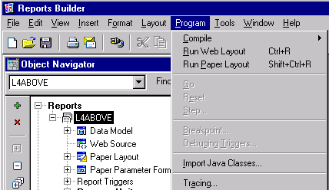
Previewing Reports

Slide 12
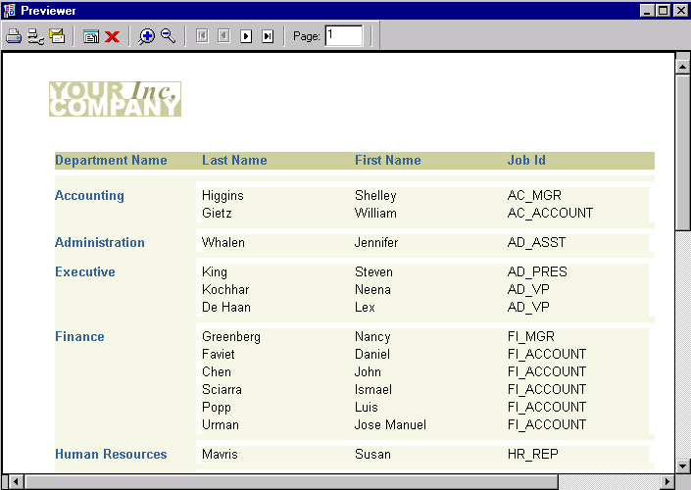
Print Preview
1
2
3

Slide 13
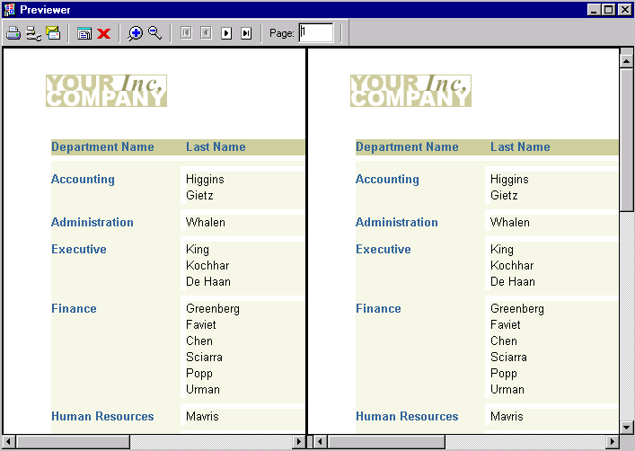
Print Preview
1
2
3
4

Slide 14
Supported File Types
  RDF
  REP
  JSP
  HTML
  XML

Slide 15
Summary
  In this lesson, you should have learned how to:
  Identify key questions to help understand user requirements
  List the simple report styles and describe their underlying structures
  Identify key design considerations:
    Report style
    Database access
    Common code
    Common objects
  List the various options for running a report

Slide 16
Practice 2 Overview
  Executing existing reports

